Slide 1


Lecture 5
Chapter 19: The Kinetic Theory of Gases
19-1 Avogadro’s number, N_{A} :
One mole of a substance contains N_{A} (Avogadro’s number) elementary units (usually atoms or molecules).
1 mole of a substance contains, N_{A} = 6.023 x 10²³ elementary units
Amedeo Avogadro suggested that all gases occupy the same volume under the same conditions of temperature and pressure. All gases contain the same number of atoms or molecules.
1 mole of He contains, N_{A} = 6.023 x 10²³ atoms
n mole of He contains total number of atoms, N = nN_{A} atoms
1 mole of O₂ contains, N_{A}= 6.023 x 10²³ molecules
n mole of O₂ contains, total number of molecules, N = nN_{A} molecules
One molar mass M of any substance is the mass of one mole of the substance.
1 molar mass, M = mN_{A} where m is the mass of 1 atom or molecule
n molar mass (sample mass), M_{sam} = mN= m(nN_{A}) = n(mN_{A}) = nM
$\frac{M_{sam}}{M}$ = $\frac{\text{n}\text{(}\text{mNA}\text{)}}{mN_{A}}$
n = $\frac{M_{sam}}{M}$

Slide 2
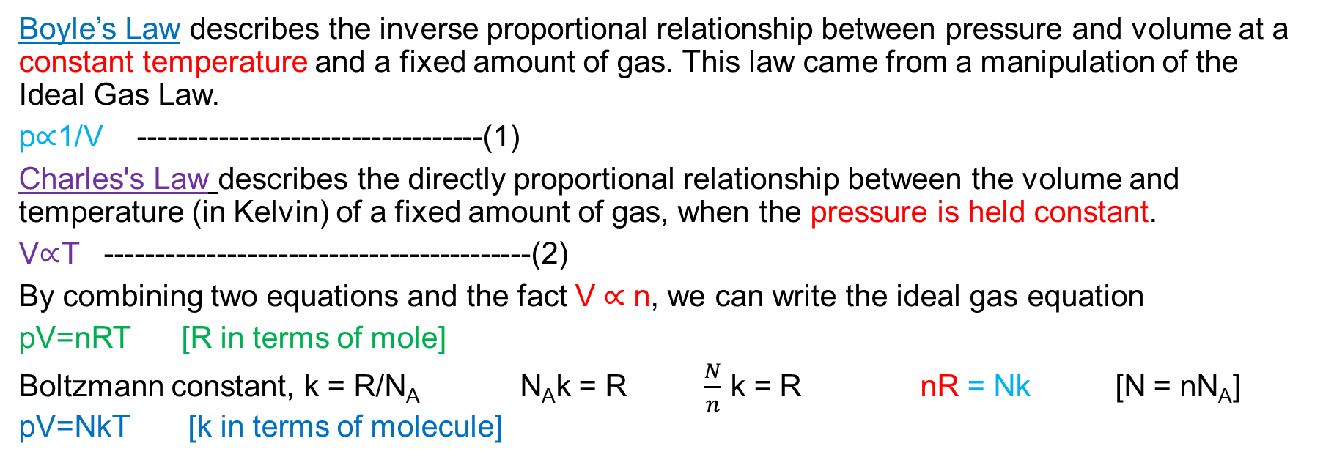
19-2 Ideal gases:
Boyle’s Law describes the inverse proportional relationship between pressure and volume at a constant temperature and a fixed amount of gas. This law came from a manipulation of the Ideal Gas Law.
p∝1/V ----------------------------------(1)
Charles's Law describes the directly proportional relationship between the volume and temperature (in Kelvin) of a fixed amount of gas, when the pressure is held constant.
V∝T ------------------------------------------(2)
By combining two equations and the fact V ∝ n, we can write the ideal gas equation
pV=nRT [R in terms of mole]
Boltzmann constant, k = R/N_{A} N_{A}k = R $\frac{N}{n}$ k = R nR = Nk [N = nN_{A}] pV=NkT [k in terms of molecule]
Ideal gas: It governs the macroscopic properties. We can deduce many properties of the ideal gas in a simple way. Although there is no such thing in nature as a truly ideal gas, all real gases approach the ideal state at low enough densities their molecules are far enough apart that they do not interact with one another.

Slide 3
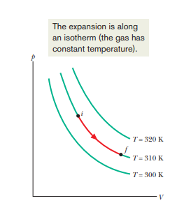
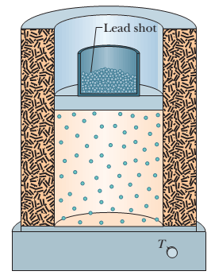
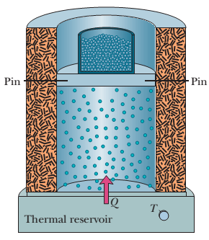
19-2 Work done by an ideal gas at constant temperature:
Suppose that we allow the ideal gas to expand from an initial volume V_{i} to a final volume V_{f} while we keep the temperature T of the gas constant. Such a process, at constant temperature, is called an isothermal expansion (and the reverse is called an isothermal compression).
i(p, T, V)
f(p+Δp, T, V +ΔV)

Slide 4
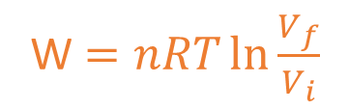
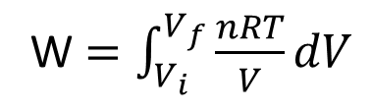
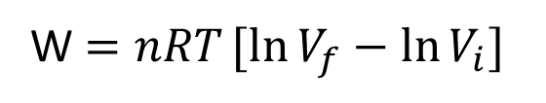
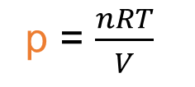
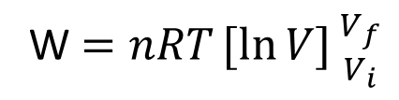
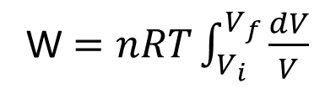
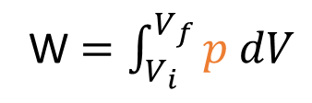
This is a general expression for the work done during any change in volume of any gas.
W $=\int_{V_{i}}^{V_{f}}{p dV}$
For an ideal gas, pV = nRT
p = $\frac{nRT}{V}$
W $=\int_{V_{i}}^{V_{f}}{\frac{nRT}{V}dV}$
W $=nRT\int_{V_{i}}^{V_{f}}{\frac{dV}{V}}$
[As T = constant, nRT = constant]
W $=nRT[ln{V]{V_{f} \atop V_{i}}}$
W $=nRT[ln{V_{f}−\ln{V_{i}] } }$
W $=nRT\ln{\frac{V_{f}}{V_{i}} }$
[Isothermal process for an ideal gas]

Slide 5
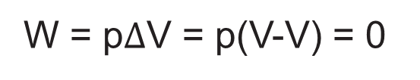
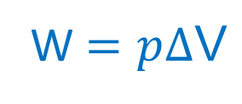
19-2 Work done at constant volume:
If the volume of the gas is constant, then the work done is as follows:
W = p$∆$V = p(V-V) = 0
W = 0
19-2 Work done at constant pressure:
If the volume changes while the pressure p of the gas is held constant, then the work done is as follows:
W $=\int_{V_{i}}^{V_{f}}{p dV=p\int_{V_{i}}^{V_{f}}{dV=p[{V]{V_{f} \atop V_{i}}}=p[{V_{f}−V_{i}{] } } }}$
W $=p∆\text{V}$

Slide 6
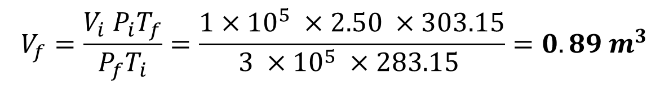
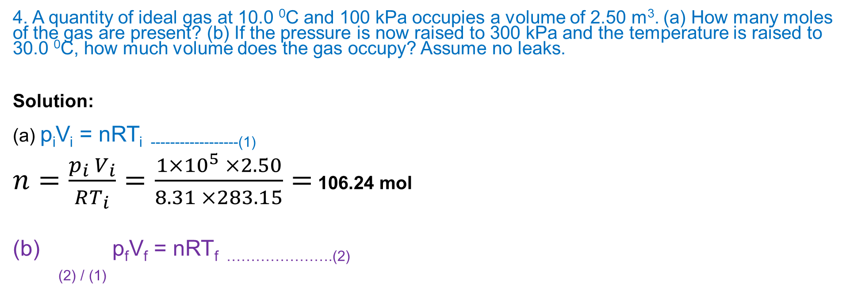
4. A quantity of ideal gas at 10.0 ⁰C and 100 kPa occupies a volume of 2.50 m³. (a) How many moles of the gas are present? (b) If the pressure is now raised to 300 kPa and the temperature is raised to 30.0 ⁰C, how much volume does the gas occupy? Assume no leaks.
Solution:
(a) p_{i}V_{i} = nRT_{i ------------------(1)}
$n=\frac{p_{i} V_{i}}{RT_{i}}=\frac{1×{10}^{5} ×2.50}{8.31 ×283.15}=$ 106.24 mol
p_{f}V_{f} = nRT_{f ………………….(2)}
_{(2) / (1)}
$$V_{f}=\frac{V_{i} P_{i}T_{f}}{P_{f}T_{i}}=\frac{1×{10}^{5} ×2.50 ×303.15}{3 ×{10}^{5} ×283.15 }=0.89 m^{3}$$
OR
p_{f}V_{f} = nRT_{f}

Slide 7
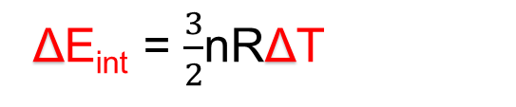
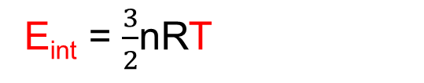
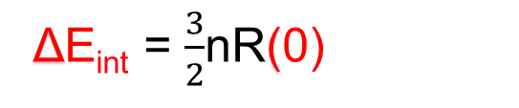
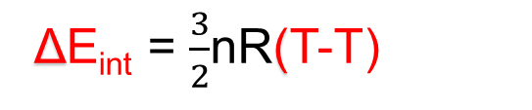
7. Suppose 1.80 mol of an ideal gas is taken from a volume of 3.00 m³ to a volume of 1.50 m³ via an isothermal compression at 30 ⁰C. (a) How much energy is transferred as heat during the compression, and (b) is the transfer to or from the gas?
Solution:
(a) ΔE_{int} = Q - W
E_{int} = $\frac{3}{2}$nRT
ΔE_{int} = $\frac{3}{2}$nRΔT
ΔE_{int} = $\frac{3}{2}$nR(T-T)
[Isothermal process, T= constant]
ΔE_{int} = $\frac{3}{2}$nR(0)
ΔE_{int} = 0
0 = Q - W
Q = W

Slide 8
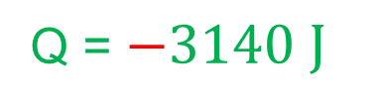
$W=nRT\left.ln\right({\frac{V_{f}}{V_{i}}})=1.80 ×8.314 ×303\ln\left( \frac{1.50}{3.00}\right)=−3140 J$
Q = W
Q = $−3140 J$
(b) The heat is transferred from the gas.

